Slide 1
Foundation of Cloud & Virtualization

Slide 2
Learning Outcomes
LO 1 : Comprehension: Explain the evolution of the cloud-native landscape and the fundamental challenges that necessitate adoption of CNCF standards: Analyze system requirements to identify actors, processes, data, and interactions
LO 4 : Apply UML-based design artifacts to communicate a complete system solution

Slide 3
Outline
History of Distributed Systems
Virtualization Taxonomy
Cloud delivery models (IaaS, PaaS, SaaS) and deployment types

Slide 4
History of distributed system

Slide 5
History of distributed system
Early Computing: Centralized Systems
One central mainframe handled computation, applications, and data
User terminals acted mainly as access devices
Applications and data were managed in one central location
System control was simpler because resources were centralized
Scalability and availability depended heavily on the central machine
Notes:
In early centralized systems, users accessed a powerful central computer through terminals. The terminals mainly served as input and output devices, while the mainframe handled processing, applications, and data storage. This model was easier to manage because everything was centralized, but it also created limitations: if the central system failed, many users could be affected, and scaling required upgrading the main machine.

Slide 6
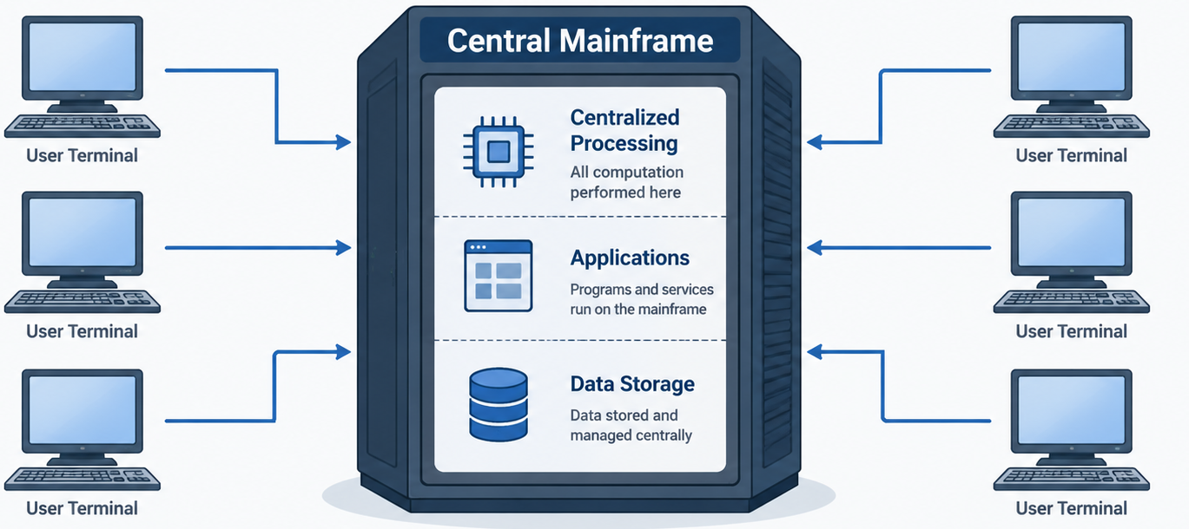
History of distributed system
Early Computing: Centralized Systems

Slide 7
History of distributed system
Limitations of centralized systems
Single point of failure
Limited by central hardware capacity
Expensive to scale
Performance bottleneck as users increase
Difficult to support large numbers of users
Notes:
Centralized systems were easier to control because computation, applications, and data were managed in one place. However, this design also created serious limitations. If the central machine failed, the whole system could become unavailable. Scaling was also difficult because improving performance usually required upgrading the main hardware, which was expensive and less flexible.

Slide 8
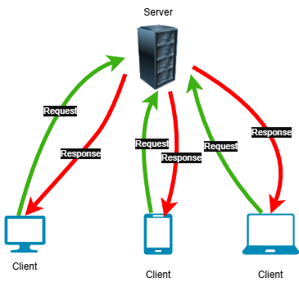
History of distributed system
Client-Server Architecture
Computing responsibilities were split between clients and servers
Clients initiated communication by sending requests
Servers handled processing and returned results
The model became dominant in networked and web-based applications
It laid the foundation for distributed computing systems
Notes:
In client-server architecture, the workload is divided between two roles: the client and the server. The client is responsible for interacting with the user and sending requests, while the server processes those requests and returns responses. This model became the foundation of many web applications and marked an important step toward more distributed forms of computing.

Slide 9
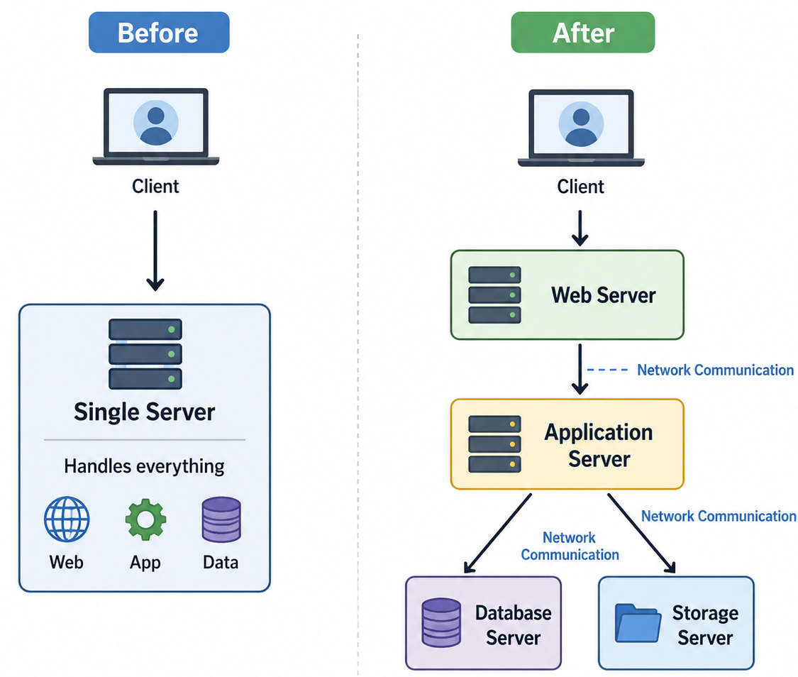
History of distributed system
From one server to multiple servers
One server was not enough for growing traffic
Workloads were distributed across multiple machines
System components were separated by responsibility
Web, application, database, and storage servers could run independently
Components communicated over a network
Notes:
As applications grew, one server was often not enough to handle increasing traffic and workload. Systems started to separate responsibilities across multiple servers, such as web servers, application servers, databases, and storage systems. This separation made systems more scalable and flexible, but it also introduced network communication between components. At this stage, applications became closer to distributed systems.

Slide 10
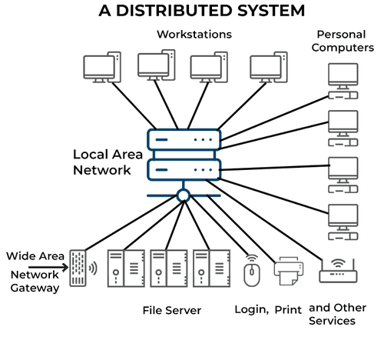
History of distributed system
Distributed systems
Multiple computers work together as one system
Components communicate over a network
Improves scalability, availability, and reliability
Can tolerate some component failures
Forms the foundation of cloud computing
Retreived from: https://estuary.dev/blog/distributed-architecture/
Notes:
A distributed system consists of multiple computers or nodes that work together as one system. These components communicate through a network and may provide different services, such as file storage, user access, printing, or external connectivity. This architecture improves scalability, availability, and reliability because the workload is no longer handled by only one machine. This concept is important because cloud computing is built on the same distributed system principles.

Slide 11
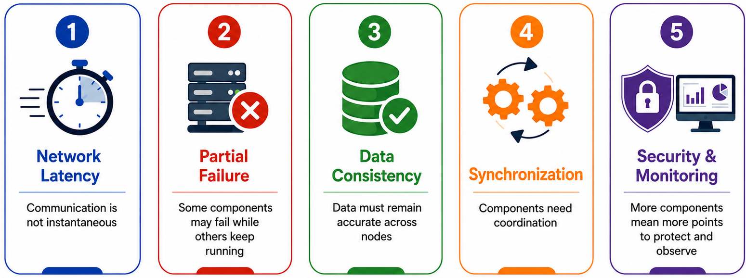
History of distributed system
Key Challenges in Distributed Systems
Notes:
A distributed system consists of multiple computers or nodes that work together as one system. These components communicate through a network and may provide different services, such as file storage, user access, printing, or external connectivity. This architecture improves scalability, availability, and reliability because the workload is no longer handled by only one machine. This concept is important because cloud computing is built on the same distributed system principles.

Slide 12
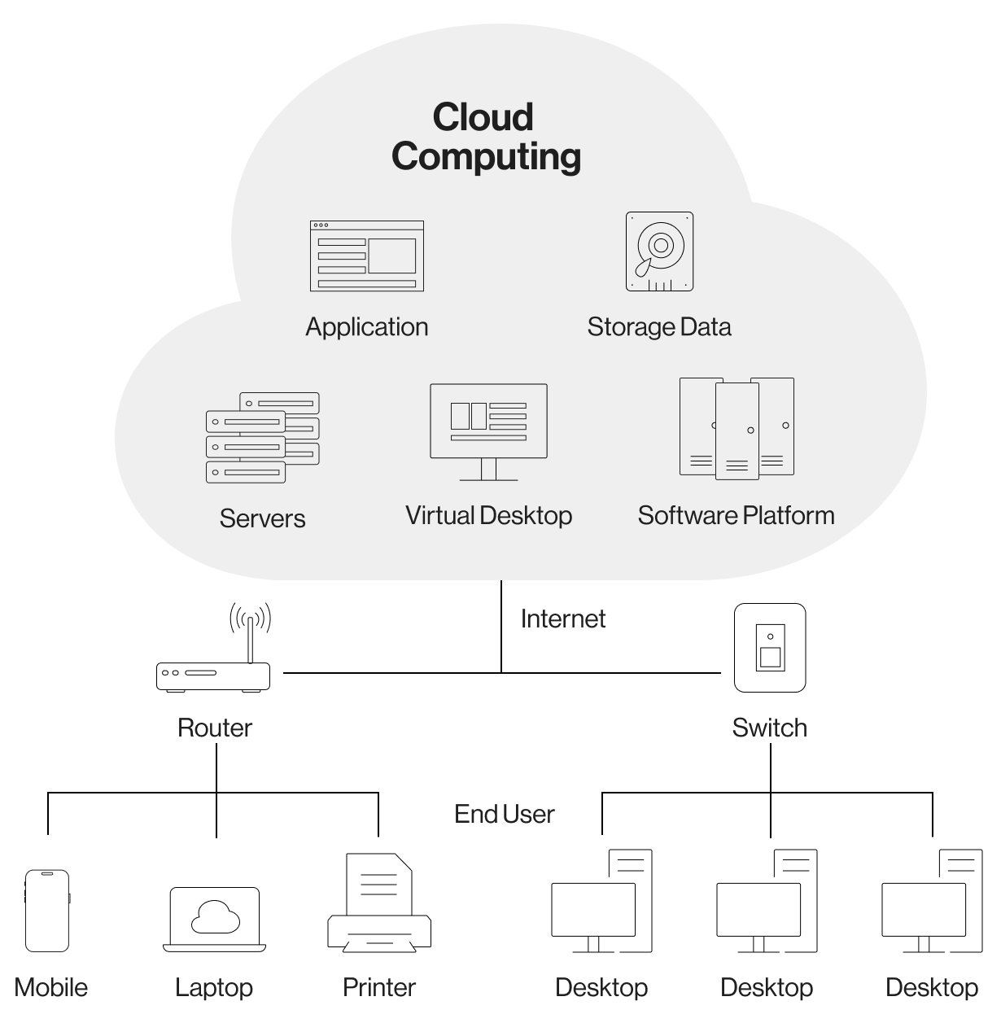
History of distributed system
From Distributed Systems to Cloud Computing
Cloud builds on distributed infrastructure
Resources are pooled and shared
Users provision resources on demand
Services are delivered through the internet
Virtualization enables efficient resource sharing
Retreived from: https://tech-stack.com/blog/a-complete-guide-to-cloud-architecture-types-benefits-techstack/
Notes:
Cloud computing can be understood as a modern evolution of distributed systems. Instead of relying on one local machine, cloud platforms use many interconnected servers, storage systems, and network resources. These resources are pooled and shared so users can request computing capacity when needed. Virtualization plays an important role because it allows physical resources to be divided and managed efficiently for many users.

Slide 13
Virtualization Taxonomy

Slide 14
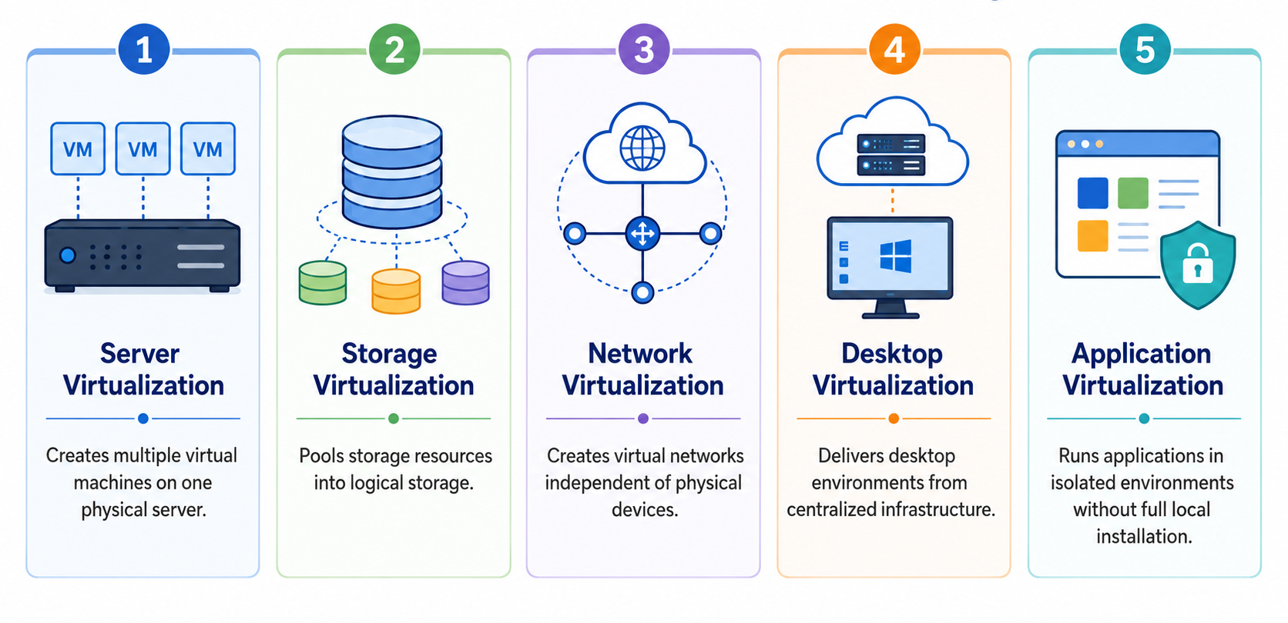
Virtualization Taxonomy
Virtualization Taxonomy
Notes:
This diagram shows a simple example of server virtualization. One physical server is divided into multiple virtual machines by a hypervisor. Each VM runs its own operating system and applications, while sharing the same physical hardware. This model is widely used in cloud computing and becomes the basis of Infrastructure as a Service.

Slide 15
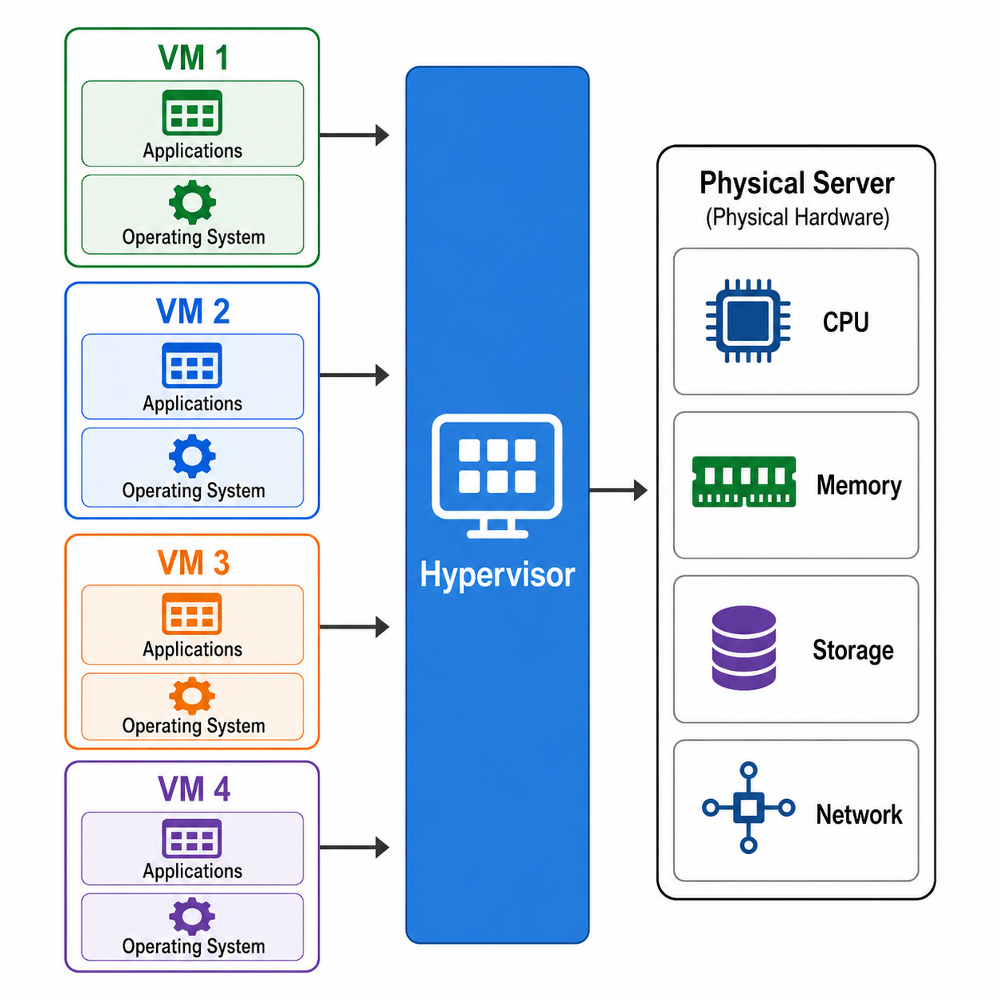
Virtualization Taxonomy
Virtualization Fundamentals
Abstracts physical computing resources
Enables multiple virtual machines on one physical server
Each VM runs as an independent environment
Hypervisor manages CPU, memory, storage, and network
Improves resource utilization and flexibility
Notes:
Virtualization is the process of abstracting physical computing resources so that one physical machine can run multiple virtual environments. Each virtual machine behaves like an independent computer with its own operating system and allocated resources. The hypervisor manages how CPU, memory, storage, and network resources are shared. This concept is important because cloud computing depends on efficient resource sharing across many users and workloads.

Slide 16
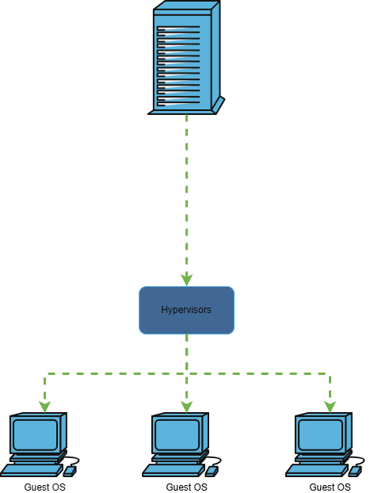
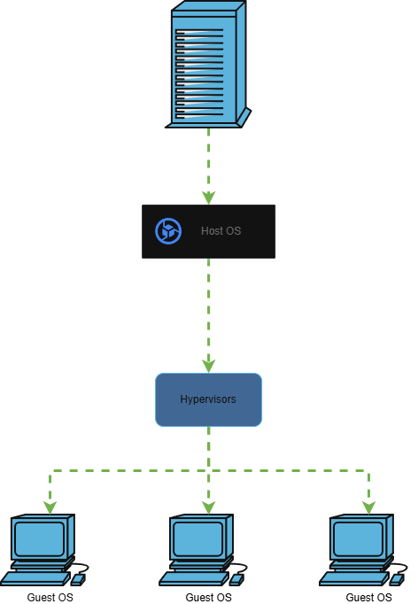
Virtualization Taxonomy
Types of Hypervisors
Type 1: Bare Metal | Type 2: Hosted
Runs directly on hardware | Runs on top of an operating system
Used in enterprise and cloud environments | Used for local development and testing
Data center / cloud | Desktop / lab
Notes:
Hypervisors are commonly divided into two types. A Type 1 hypervisor runs directly on physical hardware and is commonly used in enterprise data centers and cloud platforms because it offers better performance and control. A Type 2 hypervisor runs on top of an existing operating system, making it useful for local testing, learning, and development environments.

Slide 17
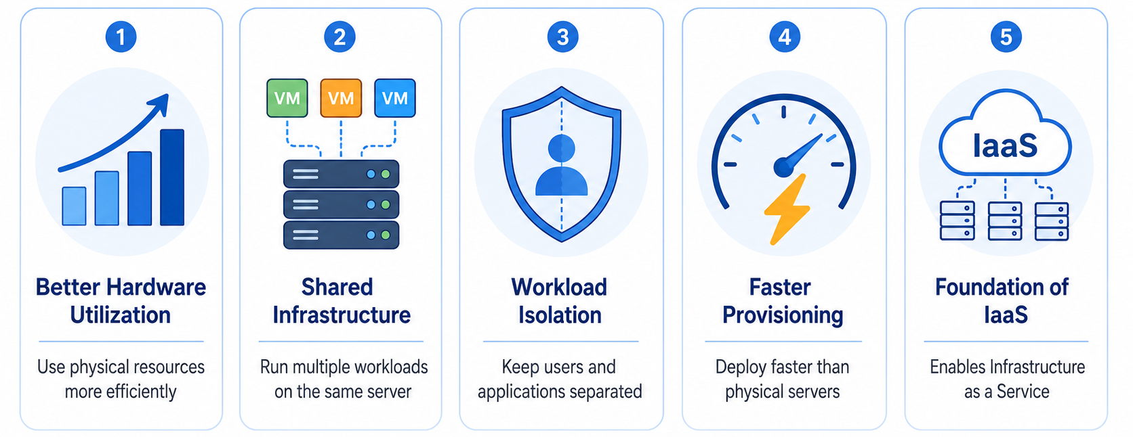
Virtualization Taxonomy
Why is it matter in cloud computing?
Notes:
Virtualization matters because it allows cloud providers to use physical infrastructure more efficiently. Instead of dedicating one physical server to one application, multiple virtual machines can run on the same server while remaining isolated from one another. This makes provisioning faster and allows cloud platforms to offer Infrastructure as a Service, where users can request virtual machines, storage, and networking resources on demand.

Slide 18
Cloud delivery models (IaaS, PaaS, SaaS) and deployment types

Slide 19
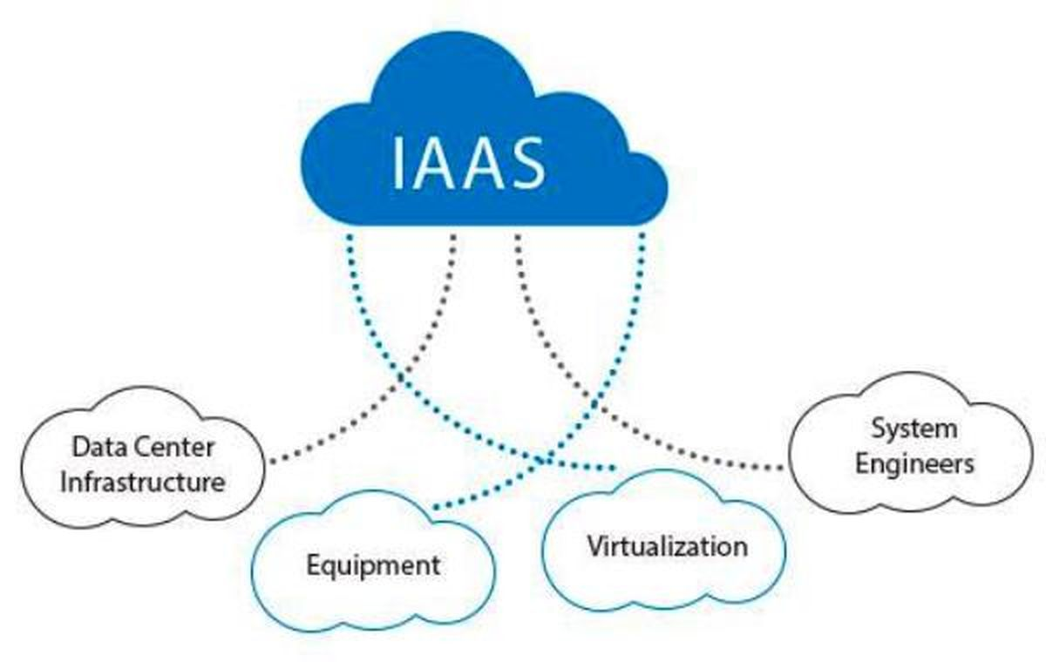
Cloud delivery models (IaaS, PaaS, SaaS) and deployment types
IAAS - Infrastructure as a Service
Provides virtualized infrastructure resources
Includes virtual machines, storage, and networks
Users manage the operating system and applications
Offers high control and flexibility
Common foundation for cloud infrastructure
Retreived from: https://blog.iron.io/what-is-iaas-infrastructure-as-a-service/
Notes:
Infrastructure as a Service provides basic computing resources through the cloud, such as virtual machines, storage, and networking. In this model, the cloud provider manages the physical infrastructure, while users still manage the operating system, applications, and data. IaaS gives users high flexibility because they can configure the environment based on their needs. This model is closely related to virtualization because virtual machines are commonly used as the main computing resource.

Slide 20
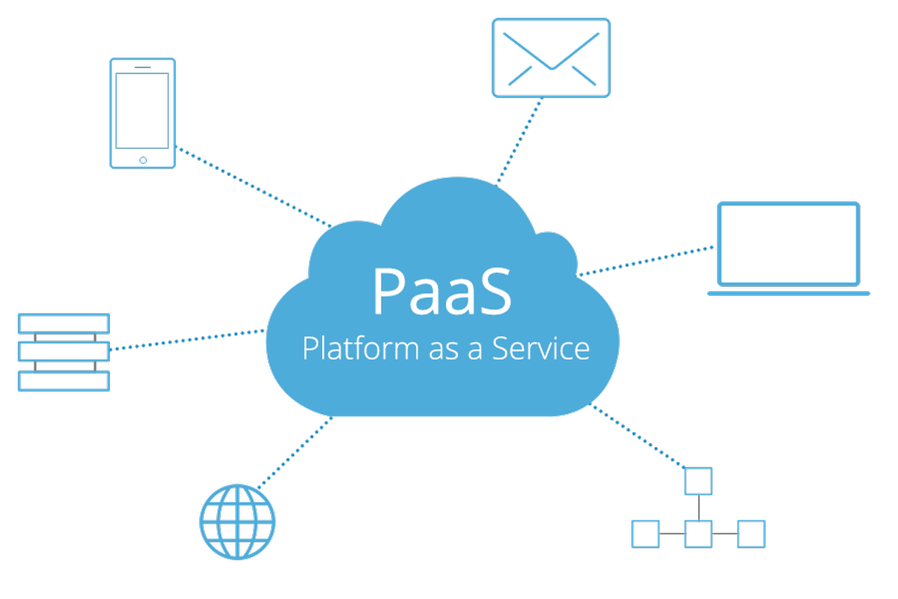
Cloud delivery models (IaaS, PaaS, SaaS) and deployment types
PAAS - Platform as a Service
Provides a managed application platform
Users deploy code without managing servers directly
Provider manages runtime, operating system, and infrastructure
Helps developers focus on application logic
Supports faster development and deployment
Retreived from: https://blog.iron.io/what-is-platform-as-a-service/
Notes:
Platform as a Service provides a managed environment for building, deploying, and running applications. In this model, developers do not need to manage servers or operating systems directly. The cloud provider manages the platform layer, such as runtime, operating system, and infrastructure. This allows developers to focus more on writing application code and delivering features faster.

Slide 21
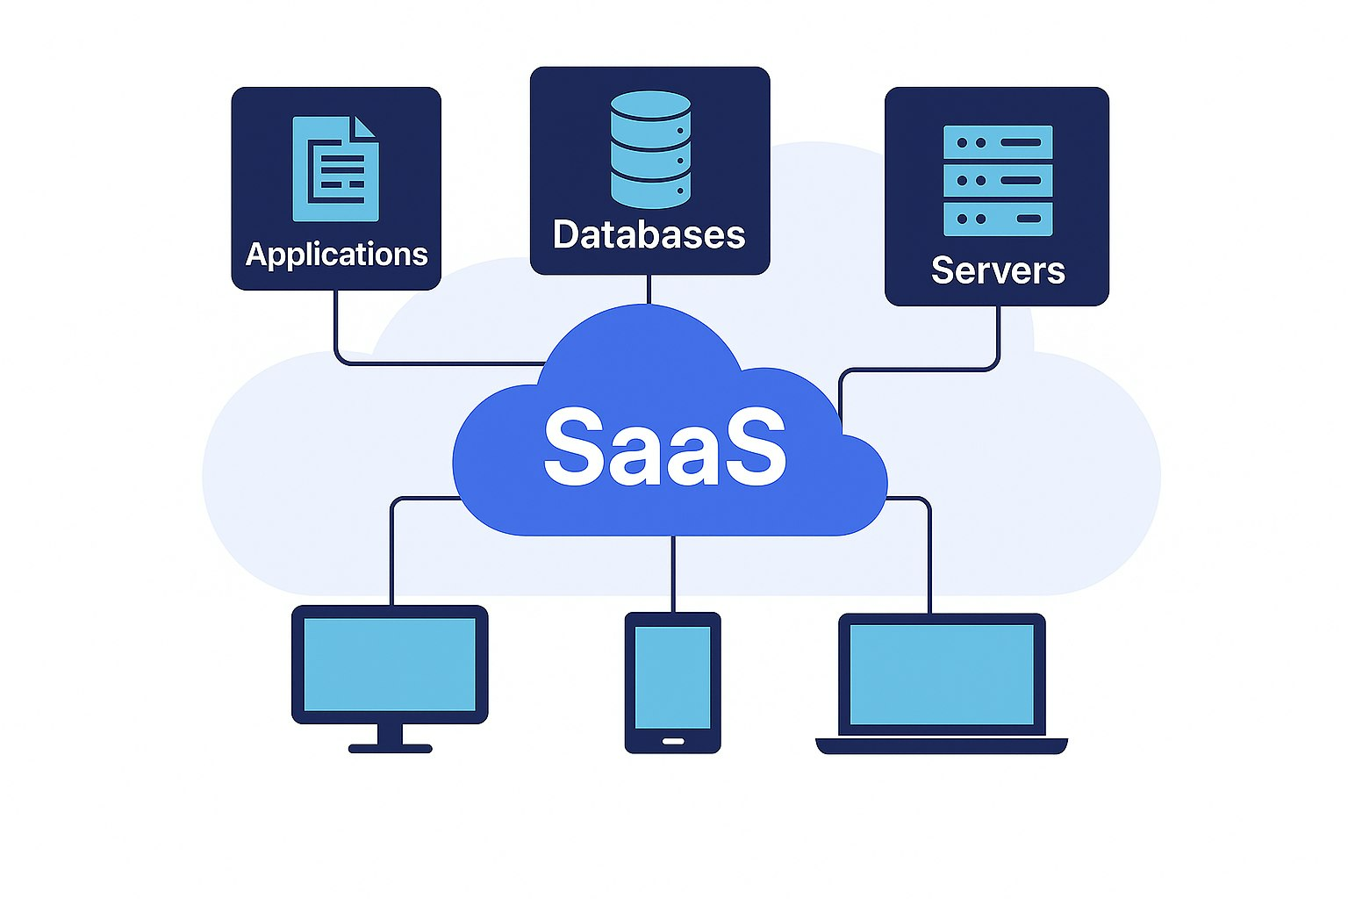
Cloud delivery models (IaaS, PaaS, SaaS) and deployment types
SAAS - Software as a Service
Provides complete ready-to-use software
Accessed through the internet
Provider manages application, platform, and infrastructure
Users focus on using the software
Examples include email, collaboration tools, and CRM systems
Retreived from: https://scalingo.com/blog/saas-paas-iaas-basics
Notes:
Software as a Service provides complete applications that users can access through the internet. In this model, users do not manage the infrastructure, platform, or application runtime. The cloud provider manages almost everything, including maintenance, updates, security patches, and availability. Users mainly focus on using the software to support their activities.

Slide 22
Cloud delivery models (IaaS, PaaS, SaaS) and deployment types
SAAS - Software as a Service
Provides complete ready-to-use software
Accessed through the internet
Provider manages application, platform, and infrastructure
Users focus on using the software
Examples include email, collaboration tools, and CRM systems
Retreived from: https://scalingo.com/blog/saas-paas-iaas-basics
Notes:
The main difference between IaaS, PaaS, and SaaS is the division of responsibility between the user and the cloud provider. IaaS gives the most control, but users also manage more components. PaaS reduces infrastructure management so developers can focus on application development. SaaS shifts most responsibilities to the provider, allowing users to simply access and use the software.

Slide 23
Cloud delivery models (IaaS, PaaS, SaaS) and deployment types
Responsibility comparison
On-Premises | IAAS | PAAS | SAAS
Application | Application | Application | Application
Data | Data | Data | Data
Runtimes | Runtimes | Runtimes | Runtimes
OS | OS | OS | OS
Virtualization | Virtualization | Virtualization | Virtualization
Servers | Servers | Servers | Servers
Storage | Storage | Storage | Storage
Networking | Networking | Networking | Networking
Managed by the client
Managed by the provider
Notes:
After understanding cloud delivery models, we can also classify cloud based on how and where it is deployed. Public cloud uses shared infrastructure from a cloud provider. Private cloud is dedicated to one organization. Hybrid cloud combines private infrastructure with public cloud services. Multi-cloud uses services from multiple cloud providers to improve flexibility or avoid depending on only one provider.

Slide 24
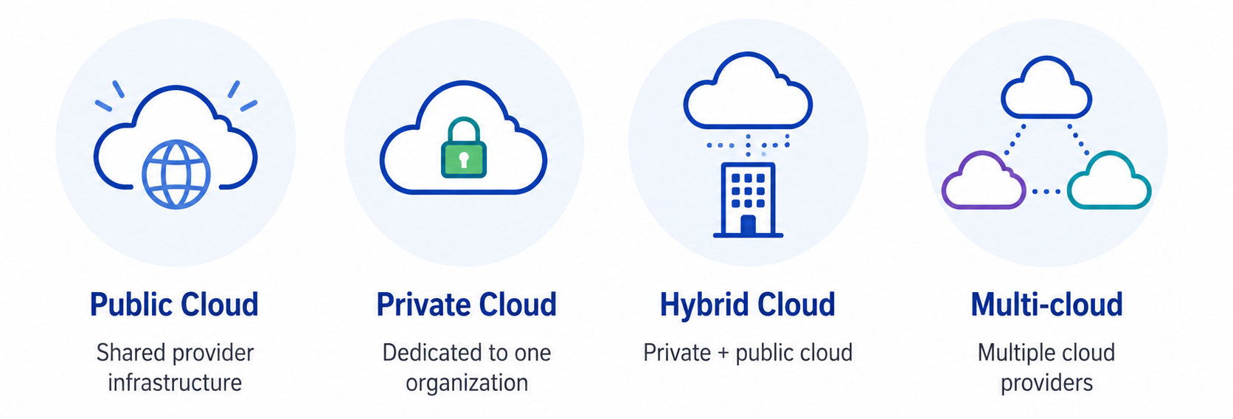
Cloud delivery models (IaaS, PaaS, SaaS) and deployment types
Cloud Deployment Types
Notes:
The main difference between IaaS, PaaS, and SaaS is the division of responsibility between the user and the cloud provider. IaaS gives the most control, but users also manage more components. PaaS reduces infrastructure management so developers can focus on application development. SaaS shifts most responsibilities to the provider, allowing users to simply access and use the software.

Slide 25
Assignment
Find best use case for each cloud delivery models:
- IaaS
- PaaS
- SaaS

Slide 26
References
Erl, T., & Barceló Monroy, E. (2024). Cloud computing: Concepts, technology, security & architecture. Pearson.
Katzer, J. (2021). Learning serverless: Design, develop, and deploy with confidence. O’Reilly Media.
Marinescu, D. C. (2022). Cloud computing: Theory and practice (3rd ed.). Elsevier.
Notes:
The main difference between IaaS, PaaS, and SaaS is the division of responsibility between the user and the cloud provider. IaaS gives the most control, but users also manage more components. PaaS reduces infrastructure management so developers can focus on application development. SaaS shifts most responsibilities to the provider, allowing users to simply access and use the software.

